Slide 1
NIRSpec MOS mode: an introduction
Themiya Nanayakkara
JWST MASTER CLASS MELBOURNE 2022

Slide 2
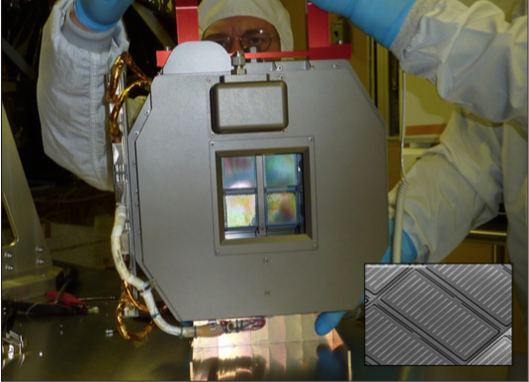
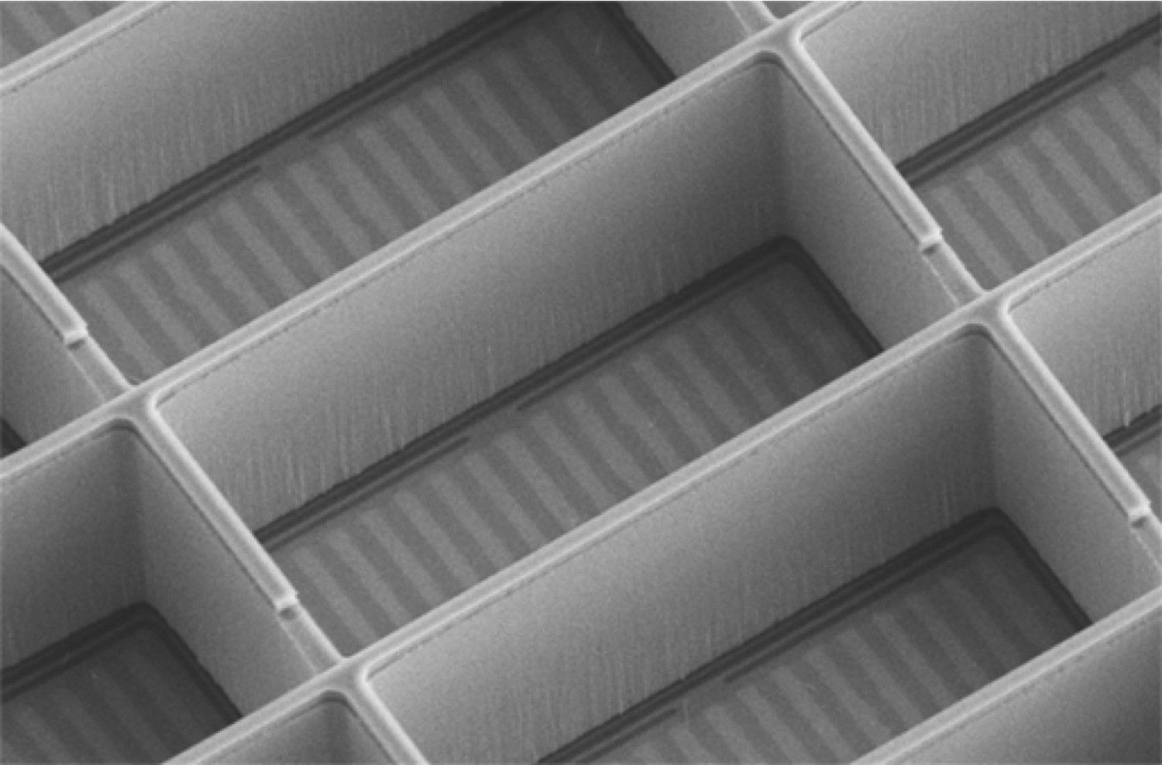
The Micro Shutter Assembly (MSA)
4 arrays of 365x171 micro-shutters
250,000 individually addressable shutters
3.6′x3.4′ field-of-view ~ 9 arcmin²
Each shutter 0.20"×0.46" (width in the dispersion direction × height)
Notes:
The Micro Shutter Assembly (MSA) is the ‘soul’ of NIRSpec, This is the hardware component of the instrument’s Multi-Object Spectroscopy mode. NIRSpec will be the first MOS-instrument to operate in space.

Slide 3
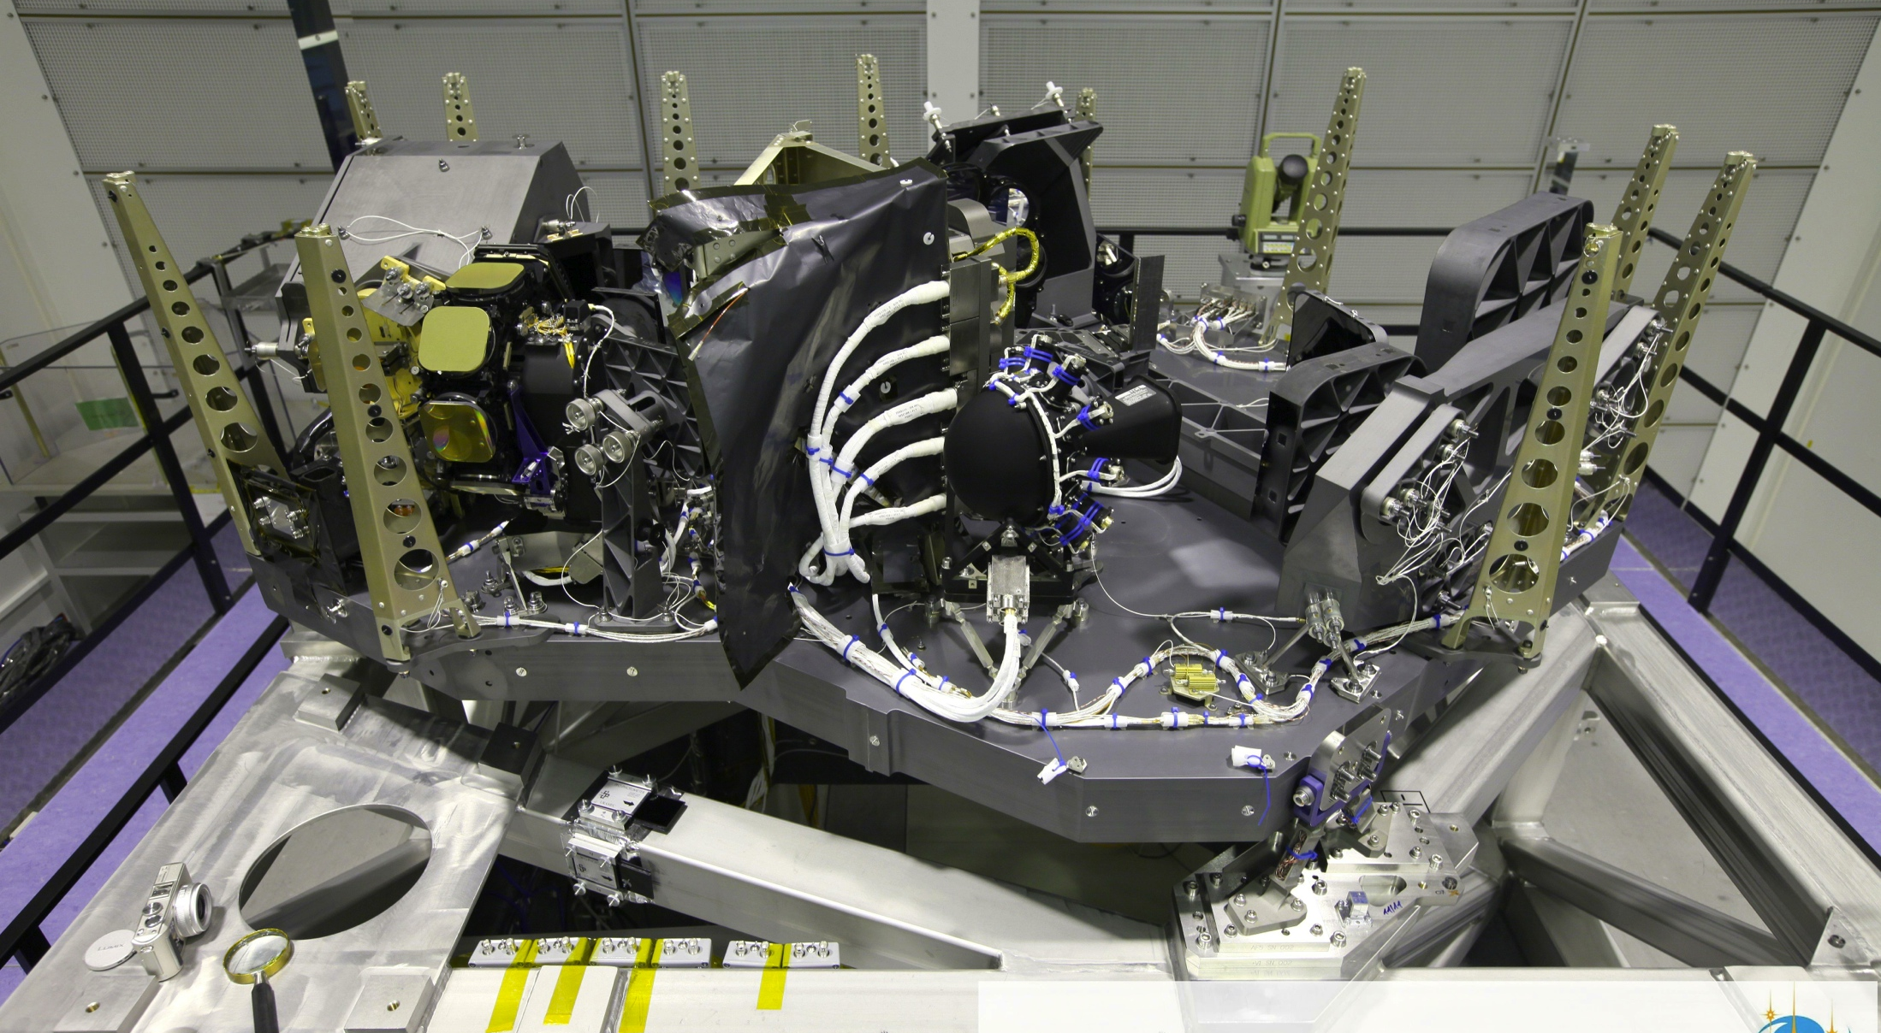
NIRSpec
MSA
Notes:
It is useful to understand the location of the MSA system within NIRSpec. This is NIRSpec without its protective cover on the occasion of a testing campaign in 2013. The MSA sub-system is located here (tip-of the arrow), in the image plane before the collimator

Slide 4
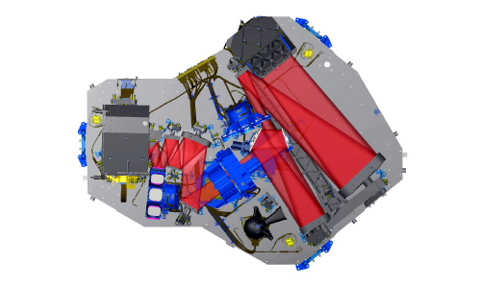
NIRSpec – light path
Pickoff mirror
FWA
FORE
CAMERA
GWA
COL
MSA
4
Notes:
In this view we can visualize the path followed by the light within NIRSpec and better understand how the instrument works. The lights collected by the telescope enters NIRSpec via the pickoff mirror and is focused by the FORE optics onto the aperture plane of the MSA. The Filter Wheel Assembly (FWA), which carries the filters for spectral band, sits in the pupil plane of the FORE optics. The collimator optics (COL) then projects the light from the slits onto the Grating Wheel Assembly (GWA), equipped with the various dispersers and a mirror for Imaging. Finally, the camera optics (CAM) focuses the (dispersed) beam onto the two detectors.

Slide 5
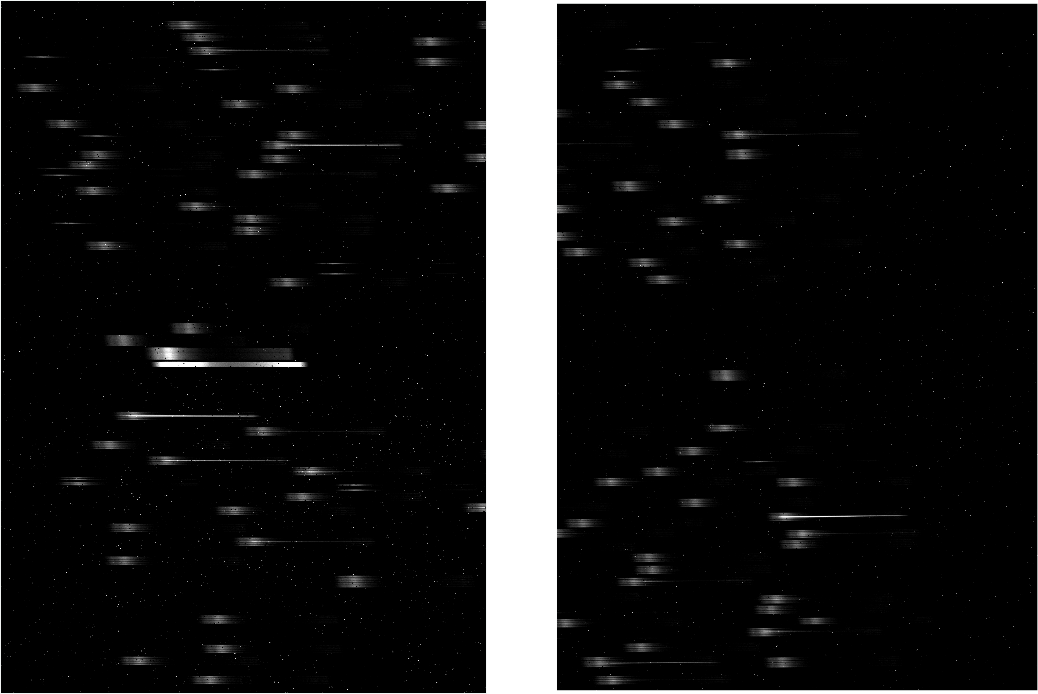
Example MOS data - Testing
Notes:
Here is an example of MOS data acquired by NIRSpec during the testing of the instrument. To obtain this image the internal calibration lamp of the instrument was used. The source used here provides uniform flat-field illumination. The two images corresponds to the count-rate recorded by the NIRSpec two detectors. The source spectrum is continuum with some absorption features, clearly visible in the image. Because of the uniform-illumination, spectra from the fixed-slit that are always open are also there [fat traces at the center]. All the other traces are from the micro-shutters that were commanded to open: roughly 100, for this test.

Slide 6
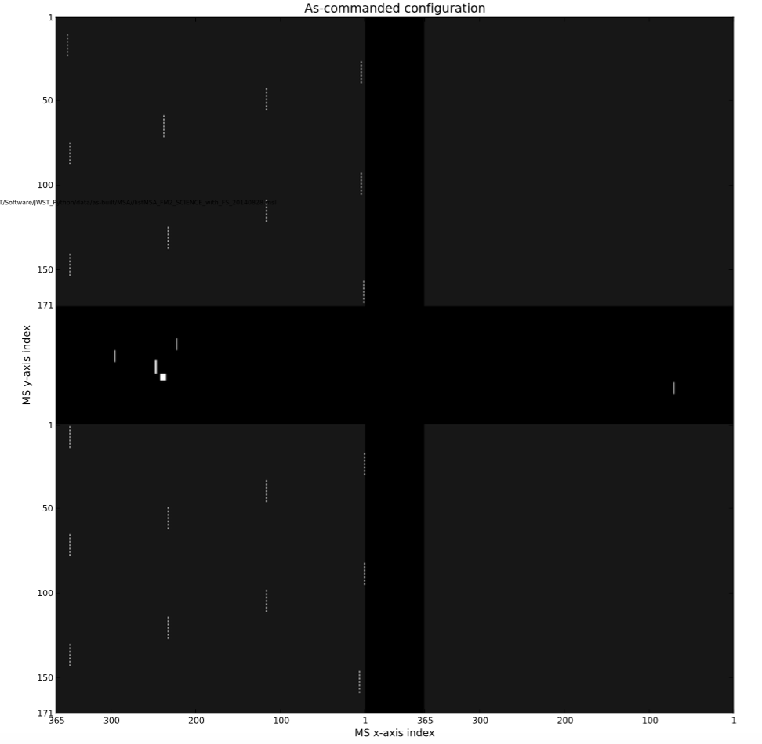
MSA configuration - Testing
Regular pattern of open micro-shutters used with flat-field illumination: Easy ☺
Notes:
This image shows the pattern of open shutters that was used to acquire the previous image. You can see the apertures of the 5 fixed slits (in the ‘cruciform’) and the regular pattern of open shutters. Because of the flat-filed illumination, it’s easy to pack many spectra together.

Slide 7
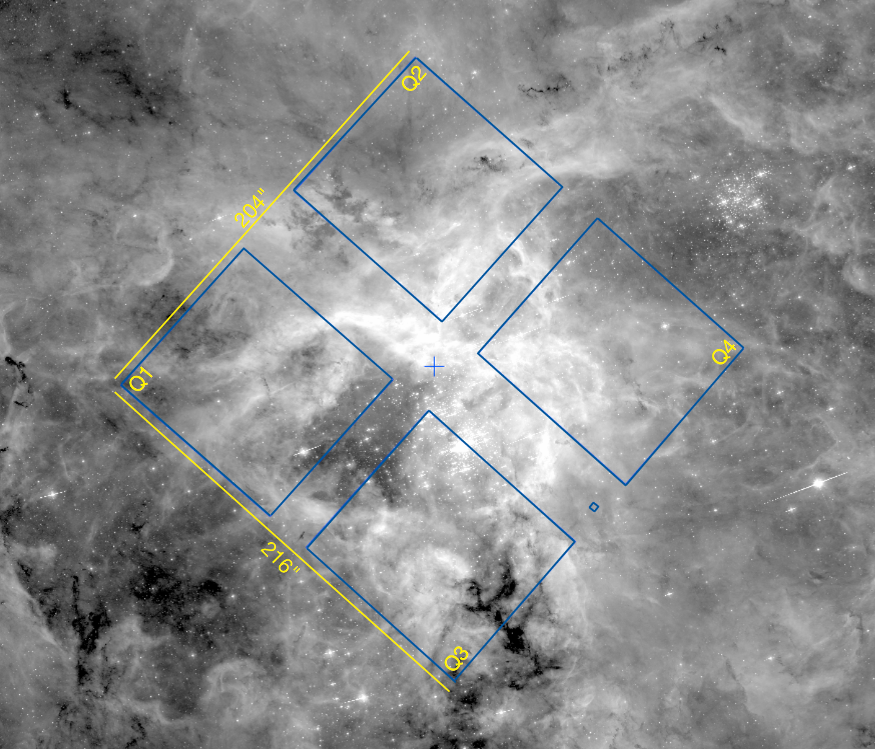
What about the planning of a real observation?
What are the considerations of such a plan?
What does the observer need to know?
?
Notes:
However, planning which shutter to open for a real-astronomic field will not be that easy. The target are scattered around the field, and the observer wishes to capture the highest number of high-priority objects, and make use of all the detector ‘real-estate’. So What are the considerations of such a plan? What does the observer need to know?

Slide 8
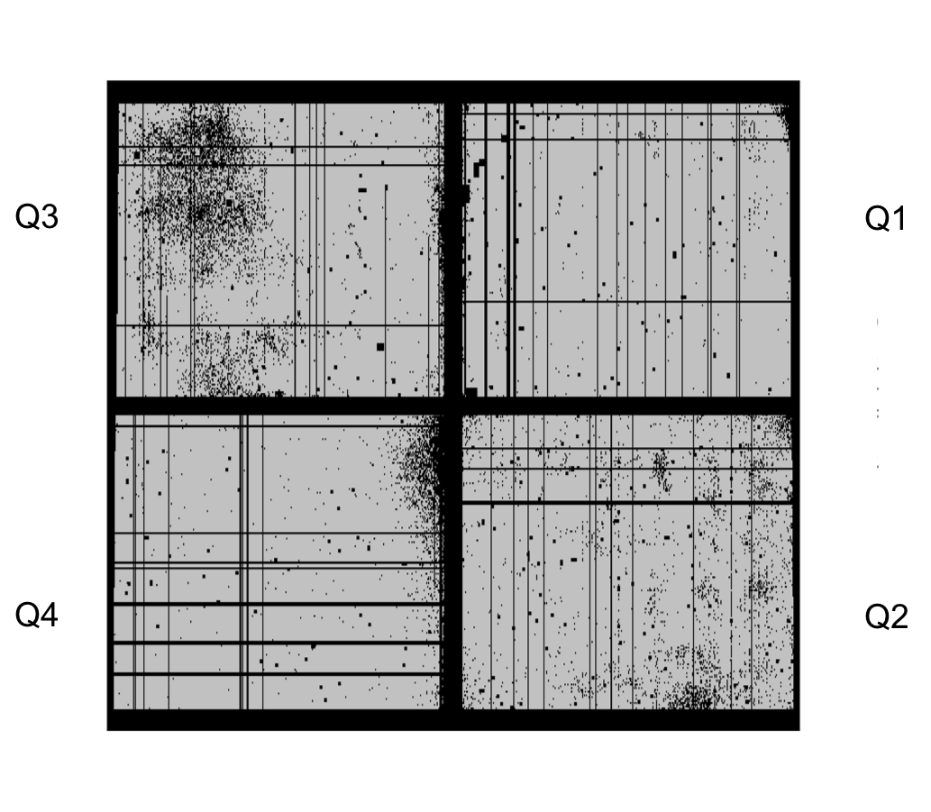
The MSA is not an ‘ideal’ grid - I
Failed Closed Shutter
Shorted rows/columns - also closed!
Notes:
This is an image of the MSA acquired during recent tests. Again we used flat-field illumination and commanded all the micros shutter to be open. As you can see there are number of shutters that are not open. Some of these are defective shutters that cannot be open, we name them ‘failed-closed- shutters. Besides these, there are entire columns or rows that cannot be open. The MSA arrays can develop electric-shorts in some places, to prevents these currents are not applied to some rows and columns that therefore cannot be commanded to open.

Slide 9
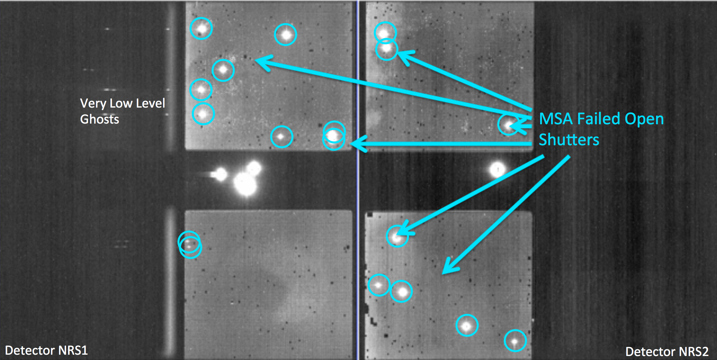
The MSA is not an ‘ideal’ grid - II
Dispersed light falling on a failed-open shutter can contaminate spectrum of target
Closed shutter are nor perfectly opaque
The status of failed open/failed closed shutters can evolve
Notes:
This is an other image of the MSA also acquired during tests. This time the MSA arrays are commanded all-close. And yet a number of shutters (18 in this case) are defective and do not close, we call this shutters ‘failed-open’ shutters.

Slide 10
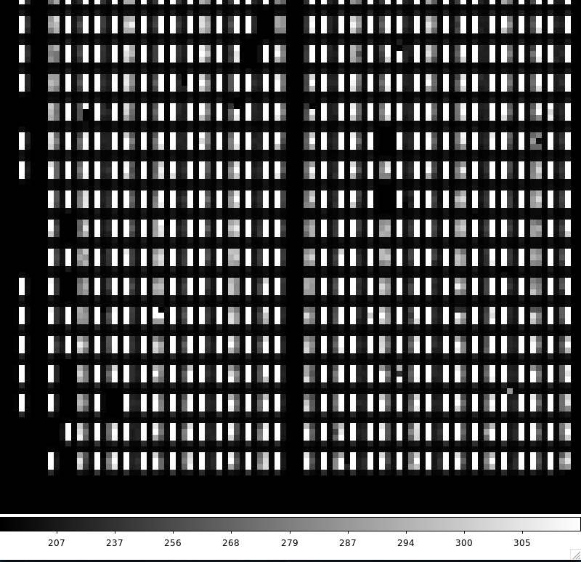
The MSA is a fixed grid
Shutter bars vignette light from an extended sources
Gap between the 2 detectors that leads to a gap in wavelength coverage
In general sources will not be centered in the aperture
Positioning sources in MSA require knowledge of optical distortions/ velocity aberrations
Notes:
The MSA is a fixed grid…

Slide 11
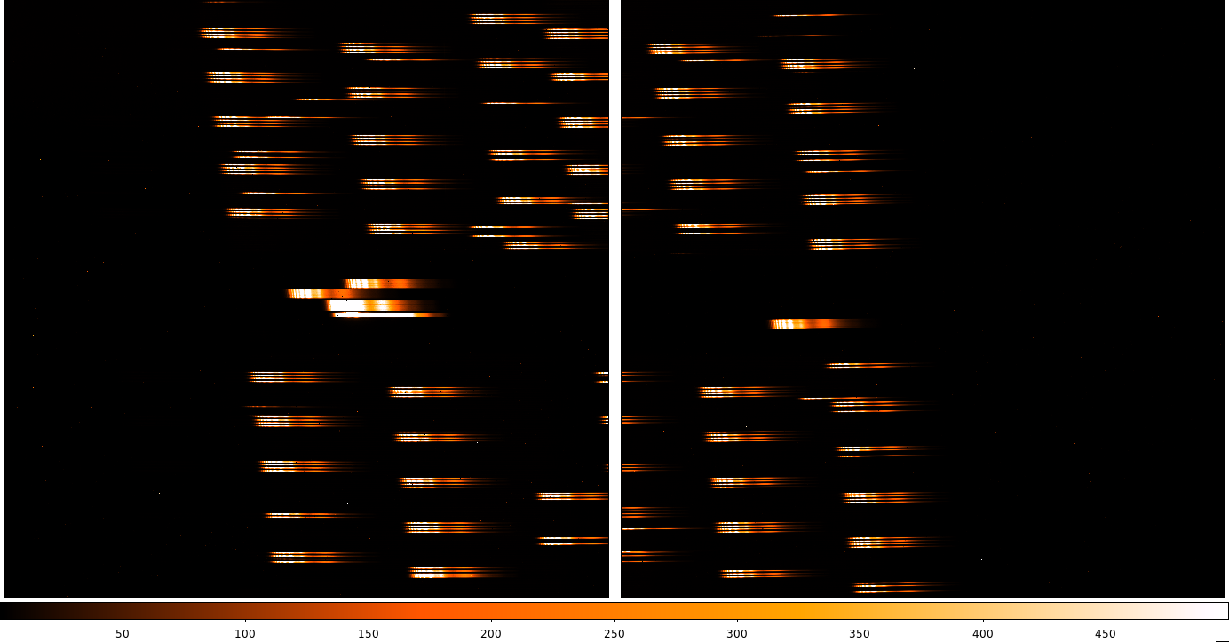
Spectra on the detector have different length: PRISM
Length of a PRISM spectrum (R~100)
Notes:
An other factor affecting the planning of a NIRSpec observation is that the spectra from the different dispersers have different length. For instance the PRISM …

Slide 12
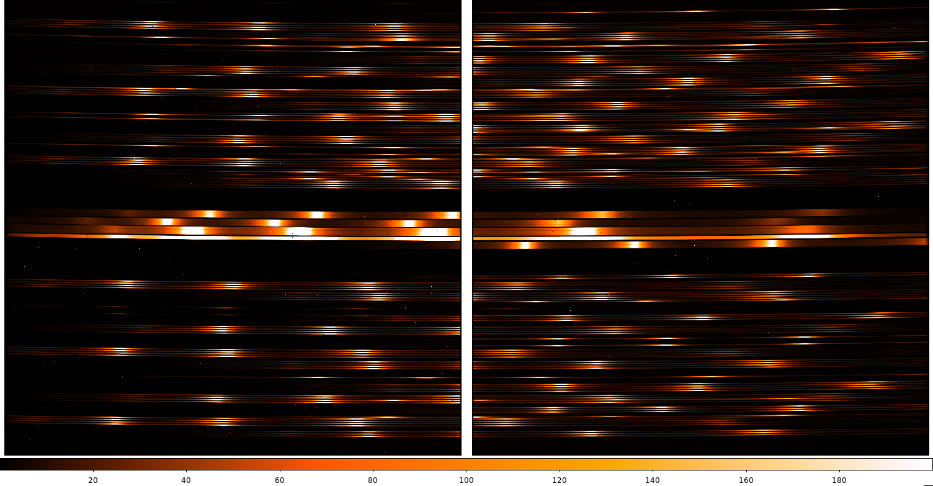
Spectra on the detector have different length: G395H
Length of G395H spectrum (R~3000)
Notes:
And a Grating (G395H):

Slide 13
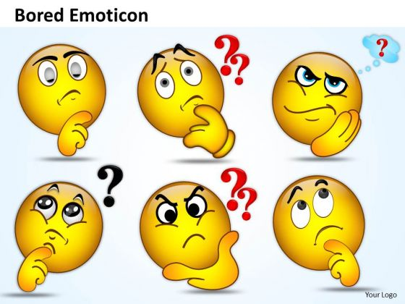
All this seem rather complicated…
Notes:
If all this seems rather complicated …

Slide 14
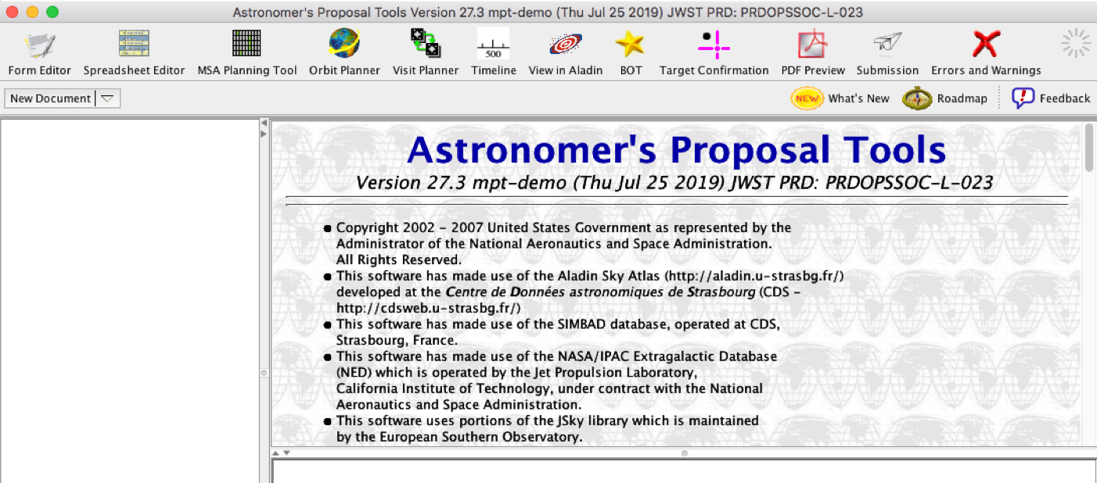
The answer: MSA Planning Tool (MPT)
Notes:
Do not worry! There’s an answer, I should say, a tool to help you out …

Slide 15
Multiplexing levels (optimal planning – real MSA)
PRISM: With catalog source densities greater than ~600 sources/arcmin² ➔ typically ~180 to 200 sources can be observed simultaneously.
Gratings: With catalog source densities greater than ~200 sources/arcmin² ➔ typically ~65 to 70 sources.
Which are the observational parameters that influence the multiplexing levels & drive the planning of a MOS observation?
Notes:
Despite the complications just outlined, using the MPT the observer can achieve the ideal level of MOS multiplexing.

Slide 16
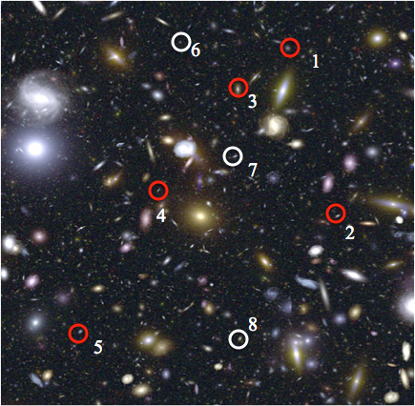
Main input to the MPT: catalog of sources
Target weights can be added in catalog: relative weights. Integer values. W(100) = 100 x W(1).
Order your input catalog by target weight before ingest.
Create a Primary candidate set, and an optional Filler candidate set
Fillers help to optimize the MSA configuration.
The best pointing is determined from the (weighted) Primaries, i.e. the weights of the primaries are used during planning.
Source ID Weight
100
100
100
100
100
1
1
1
…
Notes:
Like any other proposal, the key input to the MPT is your catalogue of sources. To specify the priority of source, the user can assign weights to each object …

Slide 17
Key parameter of MPT algorithm: Monte Carlo reshuffle
User can choose whether to re-order the Primary candidate list at each pointing. This can increase the number of targets observed at that pointing.
Notes:
In the MPT there’s an option to perform ‘Monte Carlo reshuffle’ …

Slide 18
Catalogue Key parameter: astrometric accuracy
MOS mode observations can be planned using astrometry with accuracies from 5-50mas.
High precision spectral calibration needs relative positional accuracy of 15 milli-arcsec or less, which most likely requires space-based observations.
Images obtained using HST/ACS and WFC3 within the past ten years should have this level of accuracy.
In some cases, the planning of the NIRSpec spectroscopy will require NIRCam observations, a process that is called NIRCam pre-imaging. If needed, users can request NIRCam pre-imaging in their MOS proposal
Notes:
An other important parameter in the Catalogue is its astrometric accuracy

Slide 19
Key Planning Parameters: Shutter Margin
Notes:
A parameter that can strongly affect the level of multiplexing of an observation, is the size of area of the aperture where the source can be placed, or in other words, the size of the Shutter Margin … The smaller the margin the higher the multiplexing, however, the average throughput will be lower as depicted in the diagram …

Slide 20
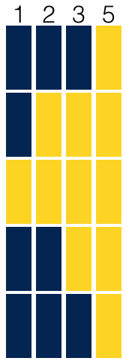
Key Planning Parameters: Slitlet size
By commanding open micro shutters, it is possible to create longer slits (in the cross-dispersion direction only) which are referred to as "slitlets".
There are four selectable Slitlets 1, 2, 3, or 5.
The spectrum from a slitlet will be segmented, with bar shadows between the individual shutters
Notes:
Other important parameters, also affecting the multiplexing levels is the size of the so called ‘Slitlets’

Slide 21
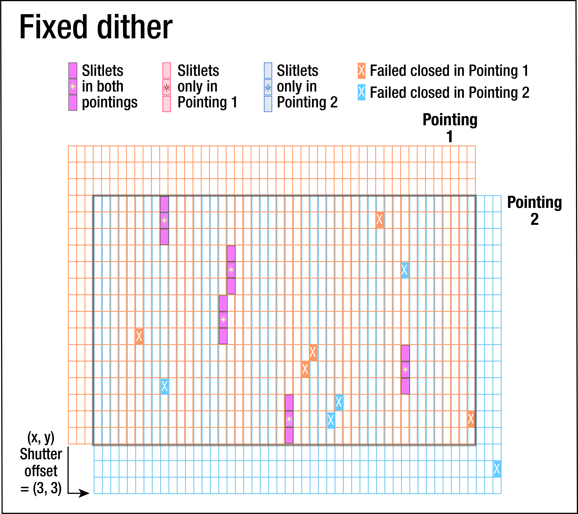
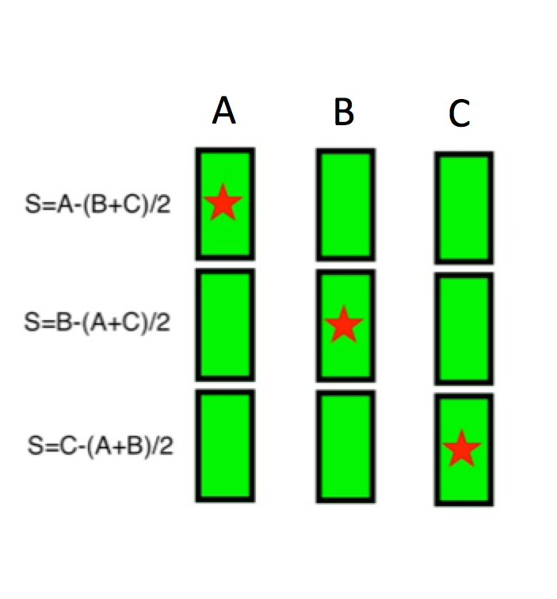
Key Planning Parameters: Nodding & Dithers
Nodding
Dither
*
*
*
*
The telescope is repositioned slightly between exposures
➔ Background subtraction
No MSA re-configuration
Same targets at same ‘depth’
Telescope repointing, translate a MSA configuration to a new location in FoV ➔Cover the,wavelength gap ➔ Different MSA configuration ➔ Different (overlapping) target sets, different ‘depth’ for non-overlapping sources
Notes:
The size of the slitlet can be dependent on the background strategy of the proposal. The default strategy will rely on ‘nodding’ … Dither are also supported …

Slide 22
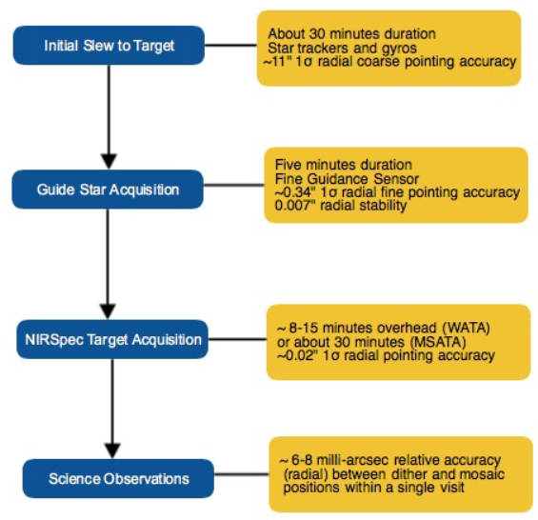
Target Acquisition
MSATA the common target acquisition method for the NIRSpec MOS science mode.
MSATA procedure uses 5–20 reference stars over the entire MSA FoV
determines their centroids on the detector
compares them to the desired positions
calculate a small-angle maneuver that adjusts the initial pointing and position angle.
NIRCam Pre-imaging or use a software like EAzY to compute TA filter magnitudes.
Notes:
Now some words about Target Acquisition for a MOS observation …

Slide 23
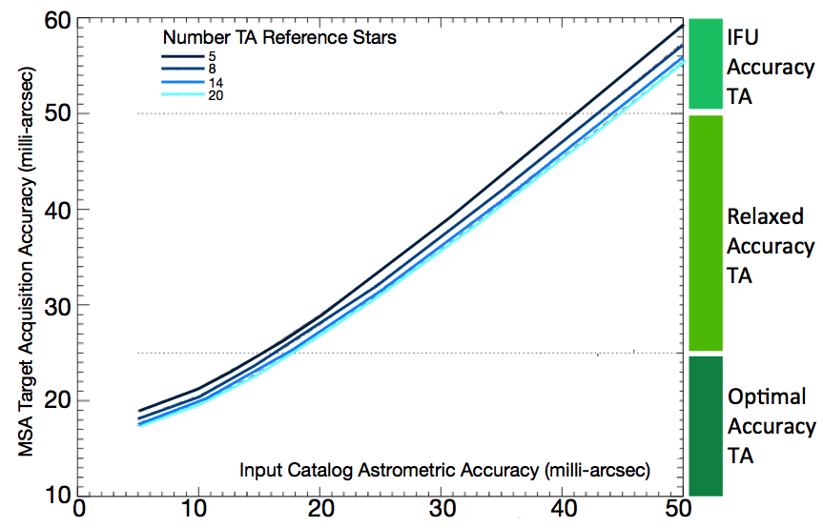
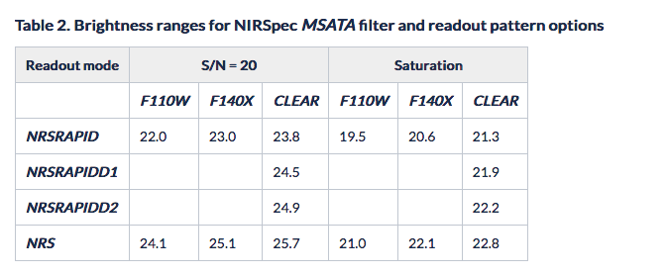
MSATA accuracy vs Catalogue accuracy

Slide 24
MOS proposal timeline: with pre-imaging
Proposal Submission: Users must request the time needed (including overheads) to observe an expected number of targets to desired exposure depths. Use the MPT with simulated or existing catalogs to explore the effects of planning choices (dithers, slit length, etc.) on the number of observable targets, and the number of MSA configurations needed to obtain all dithered exposures..
Notes:
This diagram gives the time line of a NIRSpec MOS proposal. NIRSpec. NIRSpec MOS is the only JWST mode that will require a two-stage proposal, or in other words an iteration with the STScI planning office, if the proposal is accepted.

Slide 25
MOS proposal timeline: without pre-imaging
When the Position Angle is assigned (APA). Use MPT to generate the MSA configurations for the actual observations and finalize MPT. Finalized plan will be due 6 weeks after APA is assigned.

Slide 26
Happy MOS proposal!!!
Documentation JDOX: https://jwst-docs.stsci.edu/
near-infrared-spectrograph/nirspec-observing-modes/nirspec-multi-object-spectroscopy
NIRSpec APT Templates/NIRSpec Multi-Object Spectroscopy APT Template/NIRSpec MSA Planning Tool, MPT
➔ Hands-on

